Slide 1

Multi-Agent AI Assistant with Retrieval
Augmented Generation using LangGraph, AstraDB, and LLaMA 3.1
Talha Nadeem-2021670

Slide 2
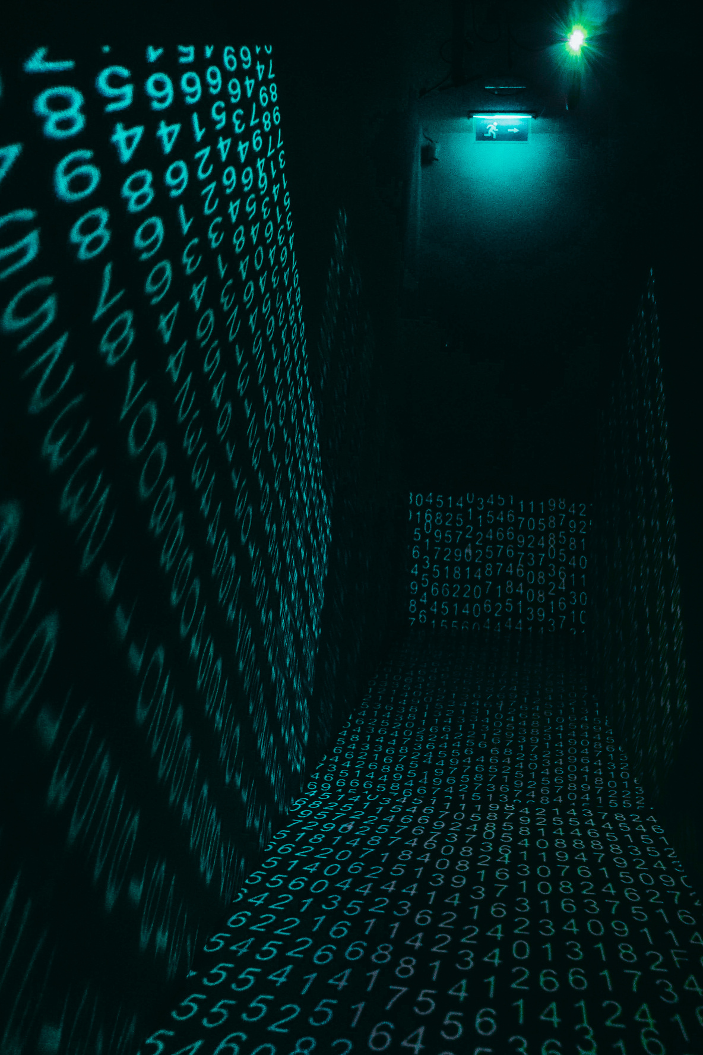
Problem Statement
Modern AI systems often lack contextual understanding across multiple data domains.
Existing assistants provide generic responses without real-time integration of domain-specific knowledge.
Scalability and modularity become major bottlenecks in intelligent assistant development.

Slide 3
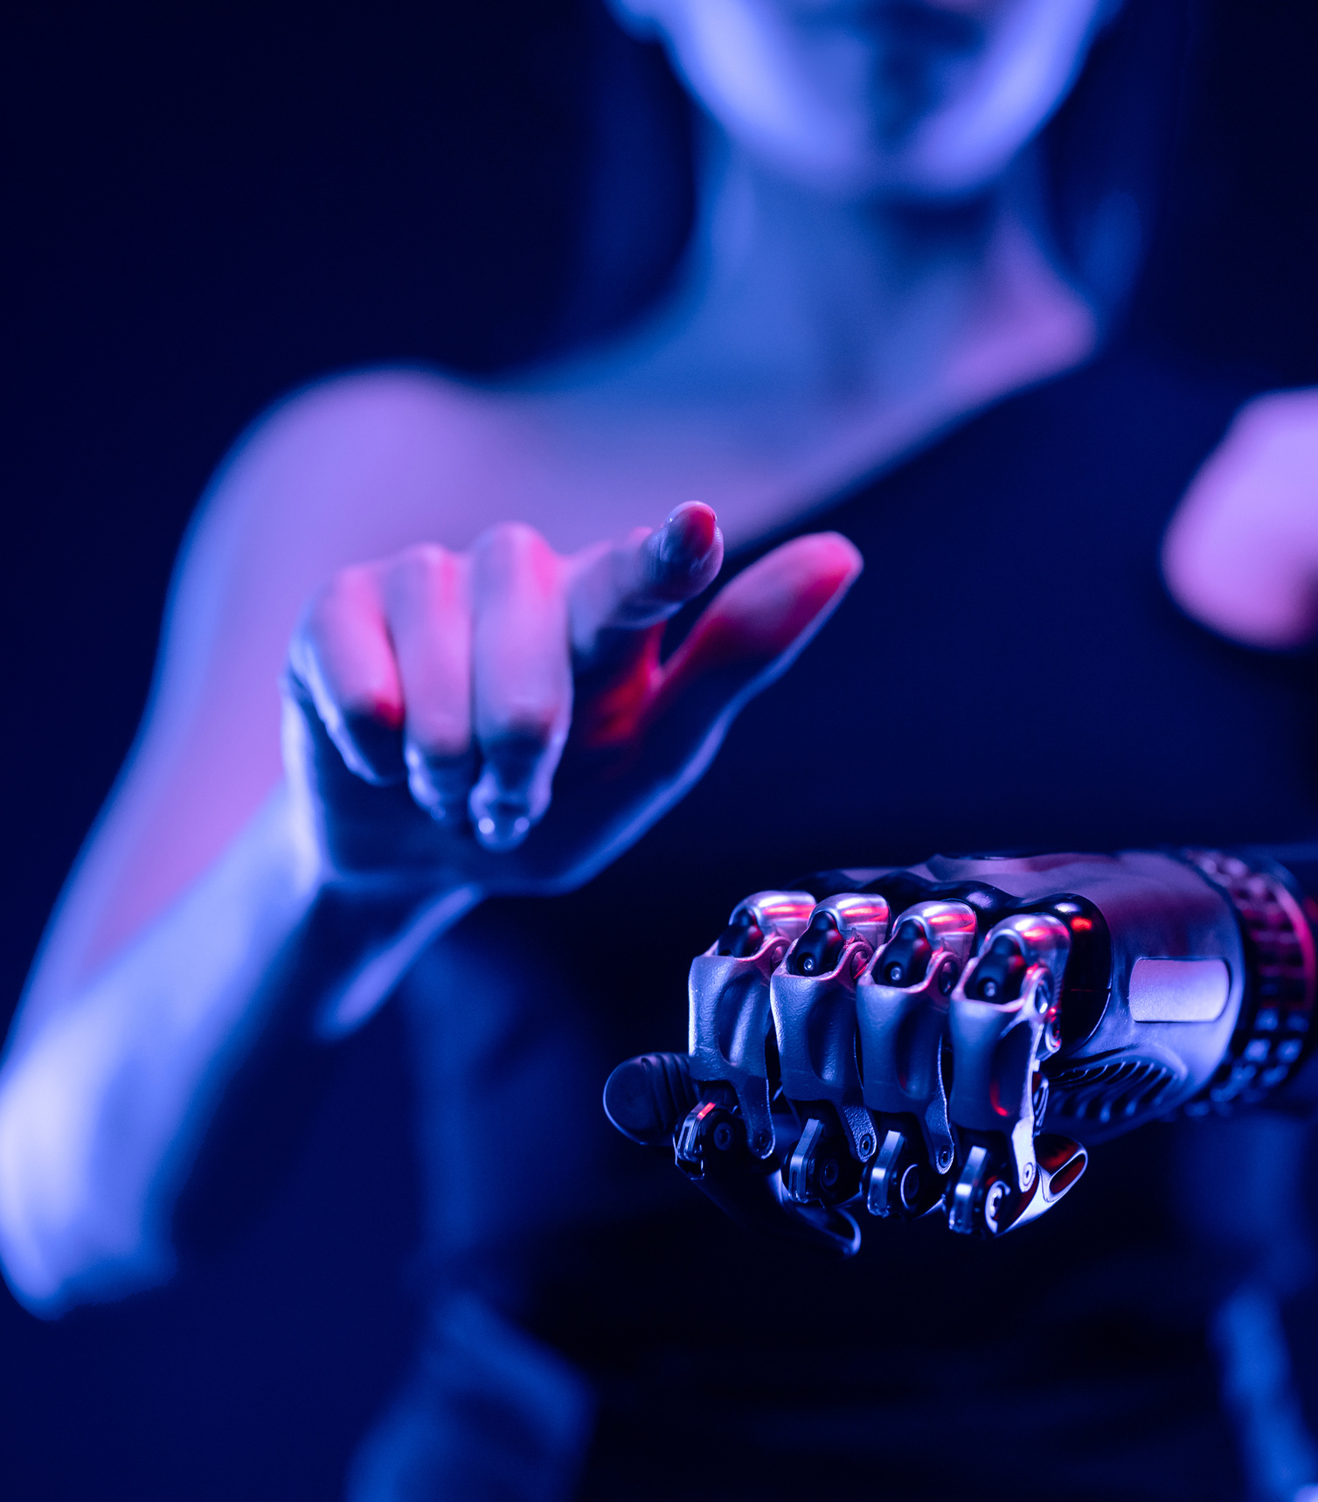
Project Objective
Goal:
To develop a scalable, intelligent AI Assistant powered by multiple cooperative agents, capable of:
Contextual understanding via Retrieval-Augmented Generation (RAG)
Integrating structured + unstructured data using LangGraph
Leveraging fast, open LLMs like LLaMA 3.1 via Groq API
Using AstraDB (Vector DB) for scalable document retrieval

Slide 4

What is RAG (Retrieval-Augmented Generation)?
Combines external knowledge sources (e.g., documents, DBs) with generative models
LLM retrieves relevant context from a database before answering
Results in factual, source-grounded response

Slide 5

Architecture Overview
System Components:
Router Agent (LLM): Decides which tool or agent to invoke
Knowledge Agent: Uses AstraDB vector search to fetch relevant chunks
External Tool Agent: Fetches info from sources like Wikipedia
LangGraph Controller: Manages states, decision flow, and agent transitions
LLM (LLaMA 3.1 via Groq): Generates final contextual response

Slide 6
LangGraph – The Orchestrator
A stateful graph-based framework for multi-agent coordination
Enables:
Routing decisions
Conditional flows
Persistent memory/state management
Supports deterministic debugging and replayable workflows

Slide 7

Data Source & Vectorization
Custom data ingested from curated web sources and documents
Process:
Chunking using RecursiveCharacterTextSplitter
Embedding using all-MiniLM-L6-v2 from HuggingFace
Stored in AstraDB (serverless vector DB)
Semantic search ensures high-precision retrievals

Slide 8
LLM – LLaMA 3.1 via Groq
Open-source model with exceptional performance
Hosted via Groq API for ultra-low latency inference
Used for:
Routing decisions
Final answer generation

Slide 9
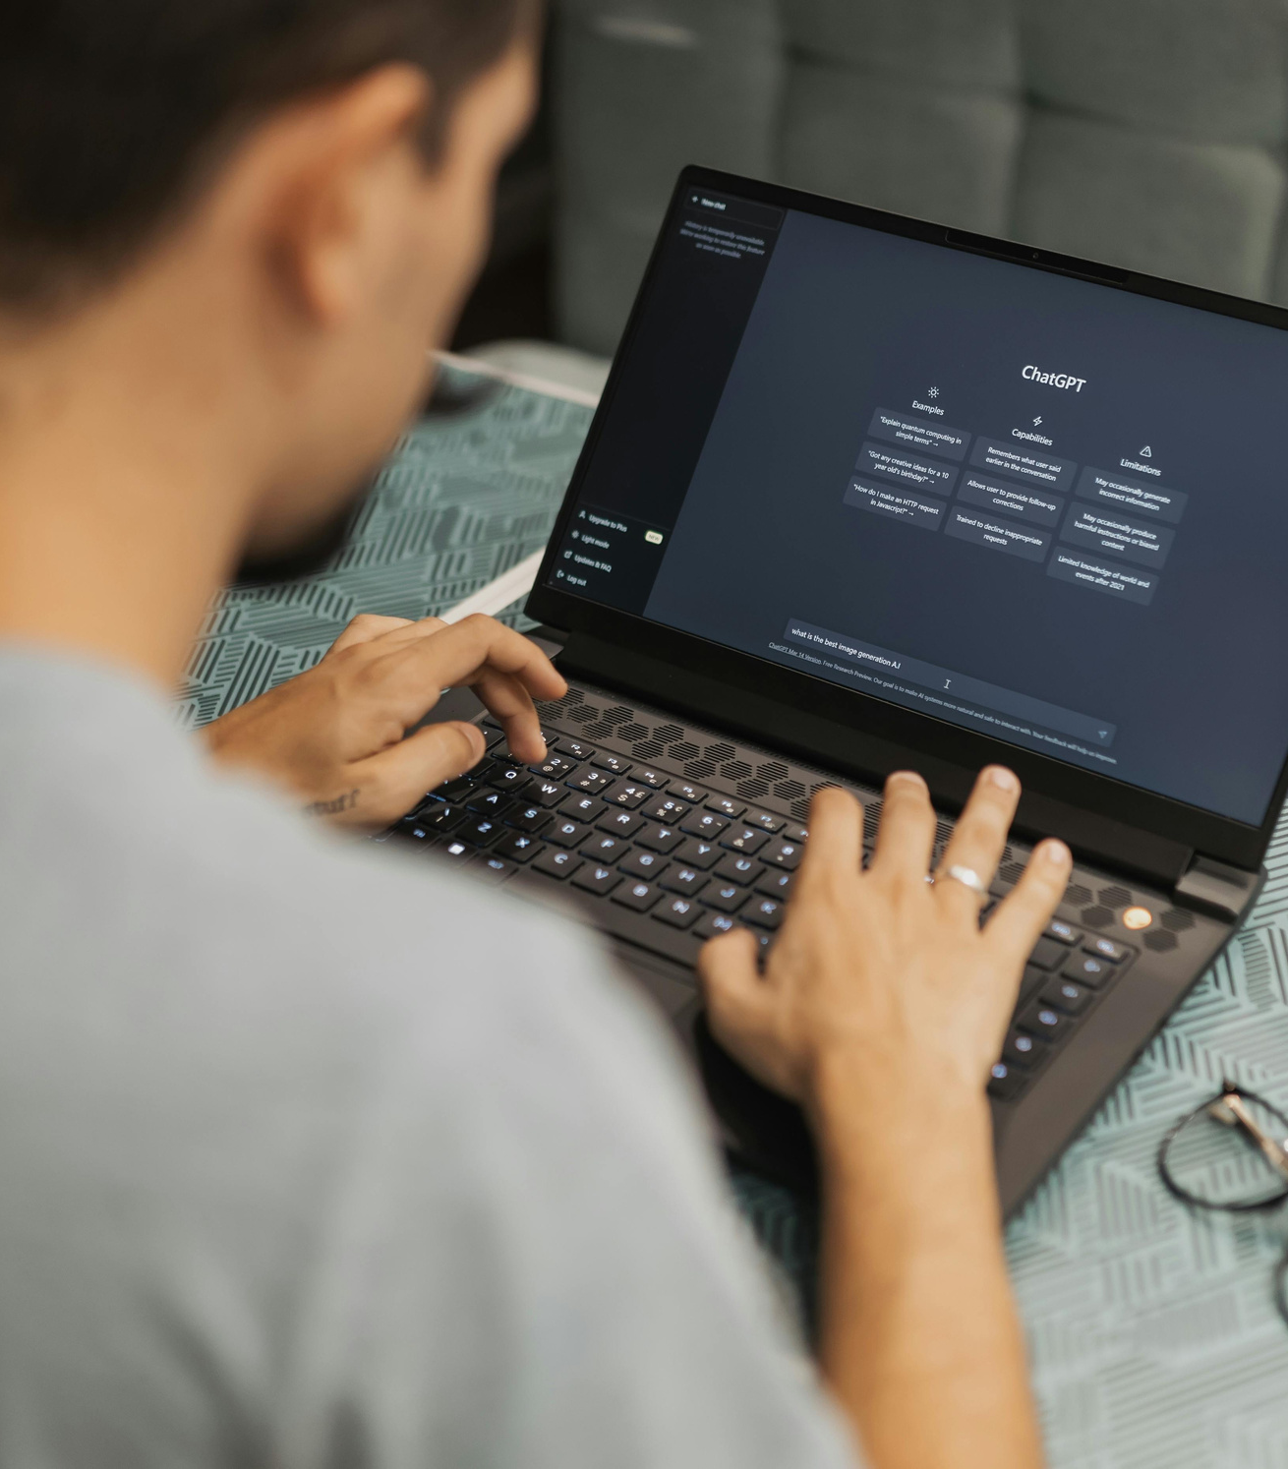
Sample Use Case
User Query: “What are adversarial attacks in AI?”
Flow:
Router Agent → AstraDB Agent → Fetch chunks
LLaMA 3.1 processes query + chunks
✨ Response: Accurate definition + sources
📈 70% faster than traditional LLM pipelines

Slide 10
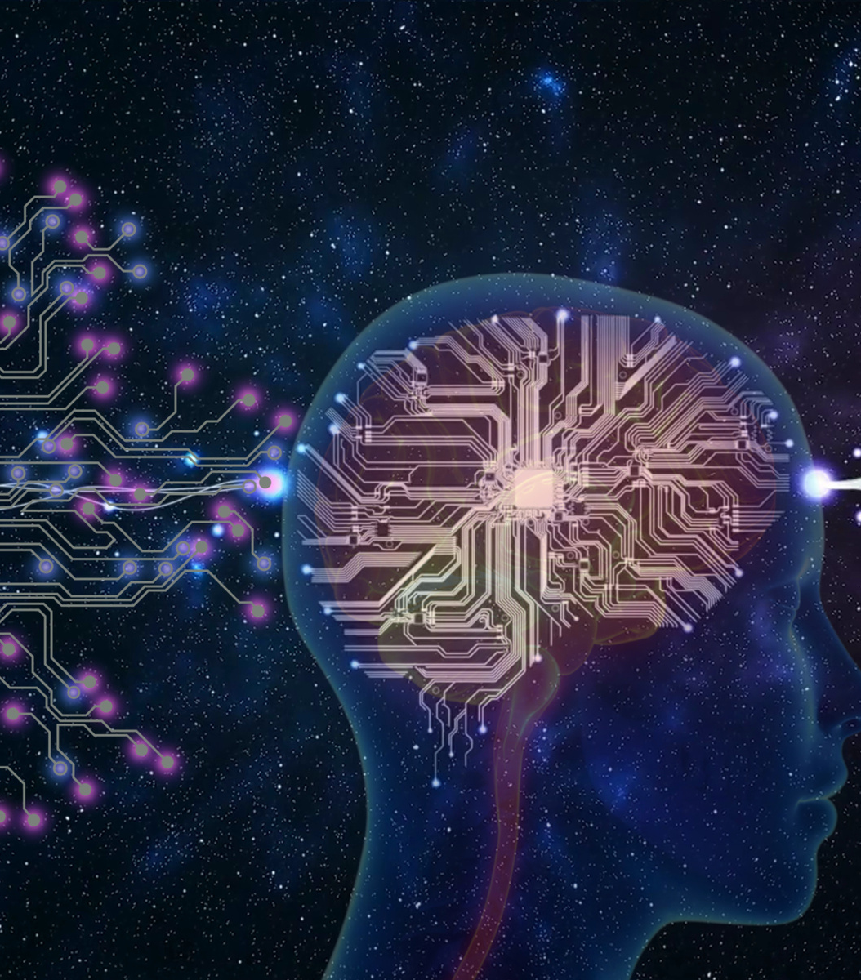
Why This Project is Original
Combines modular agentic architecture with RAG
Uses LangGraph, a cutting-edge coordination layer
Integrates both closed-book (LLM) and open-book (Vector DB) intelligence
Emphasizes explainability, modularity, and real-time adaptability

Slide 11

Potential Applications
💬 Domain-specific chatbots (Medical, Legal, Education)
📚 Enterprise Knowledge Assistants
🏛️ Government Info Portals
📊 Business Intelligence Retrieval Agents

Slide 12
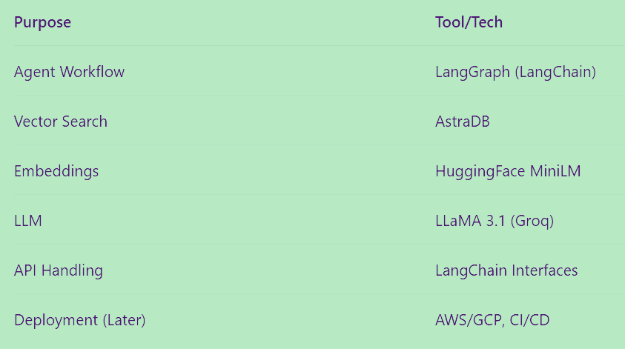
Tools & Technologies

Slide 13
Conclusion
“This project bridges the gap between raw AI power and structured intelligence, through agentic reasoning, vector search, and modular LLM control.”
Outcomes
Intelligent multi-agent AI Assistant
Grounded, accurate responses using RAG
Fully modular and extendable architecture
Ready for production-scale deployment

